Slide 1



Android UI

Slide 2
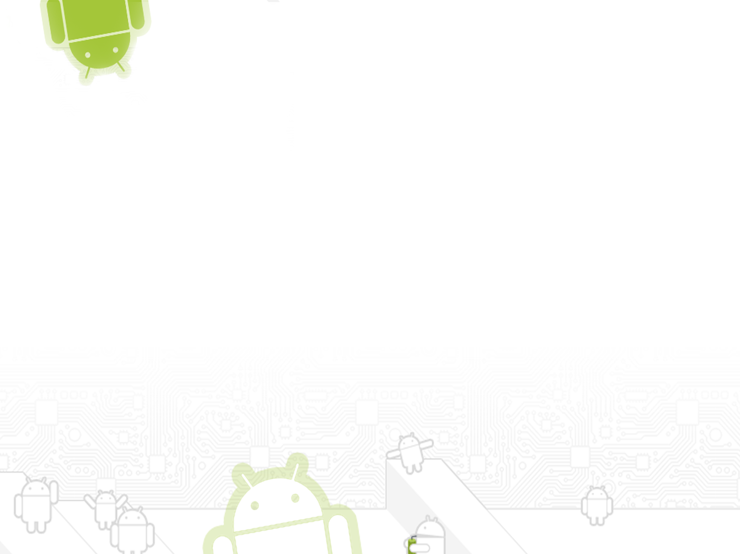

Contents
    Two Ways to Create a UI
    Fundamental Android UI Design
    Views
    Layouts
    Threading in Android

Slide 3
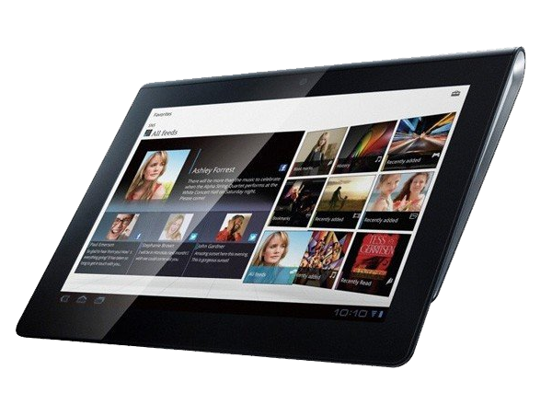
Introduction
User interface is vital to create compelling and intuitive User Interfaces for your applications. Ensuring that they are as stylish and easy to use as they are functional should be a primary design consideration. Increasing screen sizes, display resolutions, and mobile processor power has seen mobile applications become increasingly visual.

Slide 4



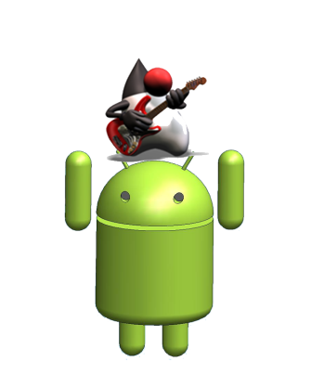
Two Ways to Create a UI
Declarative | Programmatic
You write XML code similar to HTML of a web page | You write Java code similar to Swing or AWT
They are quite different.
Often are used together to get the job done.

Slide 5

Declarative User Interface
The declarative approach involves using XML.
Similar to creating a web page using HTML.
Even a hand coded an HTML page, pretty much the same work as creating an Android screen.
One advantage of the declarative approach is that you can use “what-you-see-is-what you-get” (WYSIWYG) tools.
XML is fairly human-readable and even people who are unfamiliar with the Android platform and framework can readily determine the intent of the user interface.
A declarative UI approach is that you can get only so far with XML.

Slide 6


Programmatic User Interface
It involves writing Java code to develop UI.
Using Java AWT or Java Swing development.
Similar to many UI toolkits in other languages.
Create a button programmatically, you have to declare the button variable etc... All in all, you end up writing quite a few lines of Java.
Everything you can do declaratively, you can also do programmatically
Java also allows you to specify what happens when that button is actually clicked

Slide 7


Fundamental Android UI Design
User Interface design, human–computer interaction.
Android introduces some new terminology for familiar programming metaphors.
  Views are the basic User Interface class for visual interface elements. All User Interface controls, and the layout classes, are derived from Views.
  ViewGroups are extensions of the View class that can contain multiple child Views. By extending the ViewGroup class, you can create compound controls that are made up of interconnected child Views.
  Activities represent the window or screen being displayed to the user. Activities are the Android equivalent of a Form. To display a User Interface, you assign a View or layout to an Activity.
Android provides several common UI controls, widgets,
and layout managers. For most graphical applications.

Slide 8
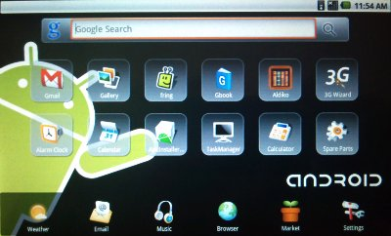
Views
All visual components in Android descend from the View class and are referred to generically as Views.
Views referred to as controls or widgets.
The ViewGroup class is an extension of View designed to contain multiple Views.
View Groups are either used to construct atomic reusable components (widgets) or to manage the layout of child Views.
View Groups that perform the latter function are generally referred to as layouts.

Slide 9
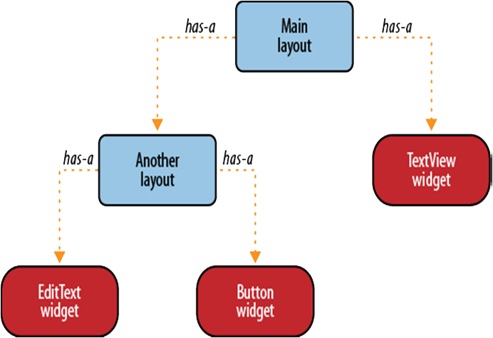


Slide 10
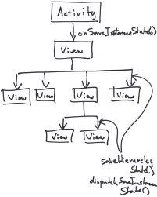
Creating Activity User Interfaces with Views
A new Activity starts with a temptingly empty screen onto which you place your User Interface.
To set the User Interface, call setContentView, passing in the View instance (typically a layout) to display.
The setContentView method accepts either a layout
resource ID or a single View instance.
Using layout resources decouples your presentation
layer from the application logic.
Presentation make it possible to specify different layouts optimized for different hardware configurations.

Slide 11
The following code snippet shows how to set the User Interface for an Activity using an external layout resource.
The following snippet shows how to assign a new TextView as the User Interface:
@Override public void onCreate(Bundle icicle) { super.onCreate(icicle); setContentView(R.layout.main); TextView myTextView = (TextView)findViewById(R.id.myTextView); }
@Override public void onCreate(Bundle icicle) { super.onCreate(icicle); TextView myTextView = new TextView(this); setContentView(myTextView); myTextView.setText(“Hello, Android”); }

Slide 12
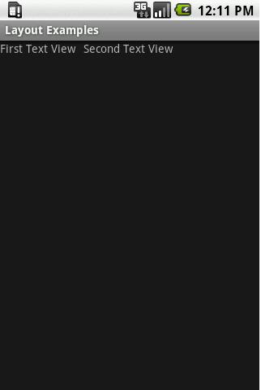

Layouts
Layout Managers (more generally, “layouts”) are extensions of the ViewGroup class designed to control the position of child controls on a screen.
The Android SDK includes some simple layouts to help you construct your UI.
To select the right combination of layouts to make your interface easy to understand and use.
Layout classes:
Frame Layout
Linear Layout
Relative Layout
Table Layout
Absolute Layout

Slide 13
Frame Layout The simplest of the Layout Managers, the Frame Layout simply pins each child view to the top left corner.
Linear Layout A Linear Layout adds each child View in a straight line, either vertically or horizontally. A vertical layout has one child View per row, while a horizontal layout has a single row of Views.
Relative Layout Using the Relative Layout, you can define the positions of each of the child Views relative to each other and the screen boundaries.
Table Layout The Table Layout lets you layout Views using a grid of rows and columns. Tables can span multiple rows and columns, can be set to shrink or grow.
Absolute Layout In an Absolute Layout, each child View’s position is defined in absolute coordinates.

Slide 14
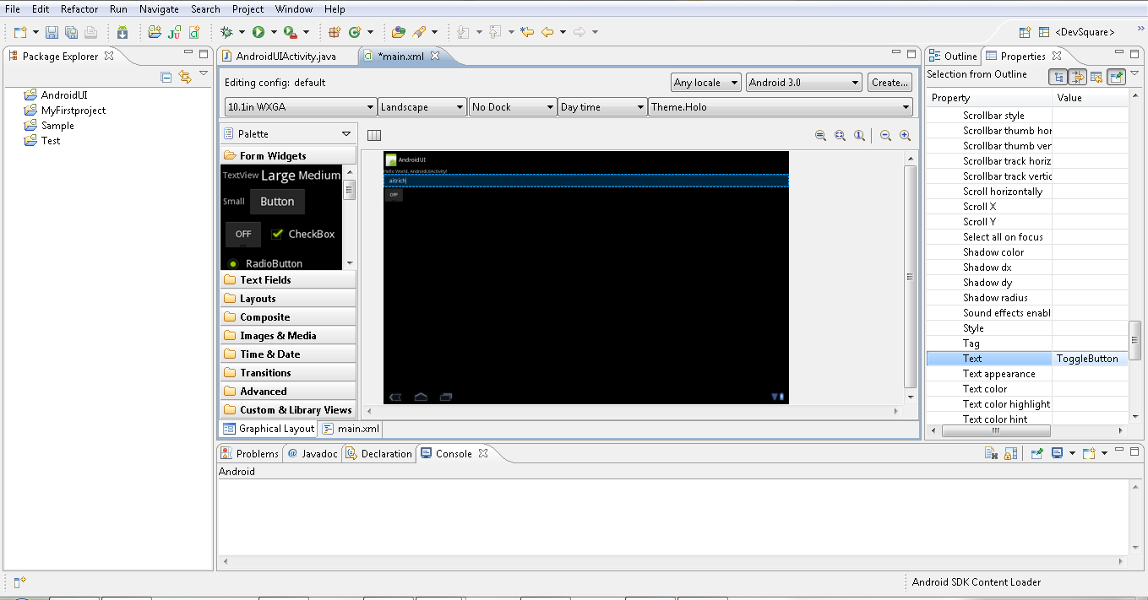
Using Eclipse to Design Layout Resources
The Android Development Plug-in for Eclipse includes a handy layout resource design.
The tool includes two tab views:
  1) The Layout view 2)The XML view

Slide 15

Defining an XML Layout Resource
The most convenient and maintainable way to design application user interfaces is by creating XML layout resources.
It creates a potential distinction between UI designers and developers.
Developers can still alter the content of a screen programmatically when necessary.
XML layout resources must be stored in the /res/layout project directory.

Slide 16
<?xml version="1.0" encoding="utf-8"?> <LinearLayout xmlns:android="http://schemas.android.com/apk/res/android" android:orientation="vertical" android:layout_width="fill_parent" android:layout_height="fill_parent" android:gravity="center"> <TextView android:layout_width="fill_parent" android:id="@+id/PhotoLabel" android:layout_height="wrap_content" android:text="@string/my_text_label" android:textSize="20dp" /> <ImageView android:layout_width="wrap_content" android:layout_height="wrap_content" android:src="@drawable/matterhorn" android:adjustViewBounds="true" android:maxHeight="250dp" android:maxWidth="250dp" android:id="@+id/Photo" /> </LinearLayout>

Slide 17
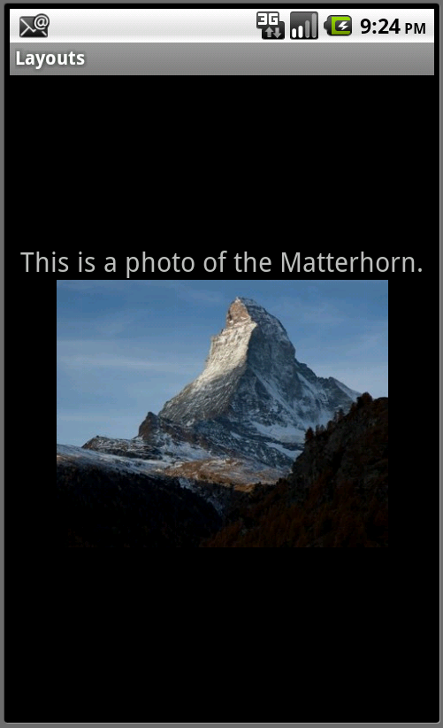
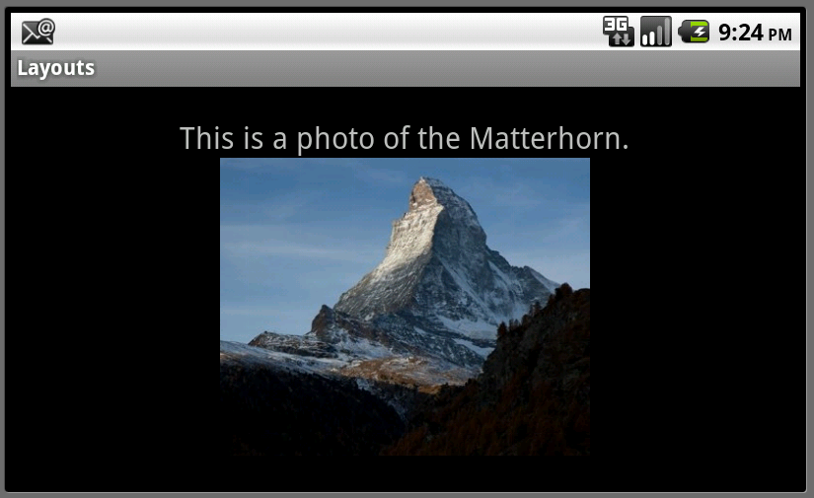
This layout represents a simple screen with two controls:

Slide 18

Threading in Android
A thread is a sequence of instructions executed in order.
Although each CPU can process only one instruction at a time.
Most operating systems are capable of handling multiple threads on multiple CPUs, or interleaving them on a single CPU.
Different threads need different priorities..
The operating system determines how much time to give each one if they have to share a CPU.
The Android operating system is based on Linux and as such is fully capable of running multiple threads at the same time.

Slide 19
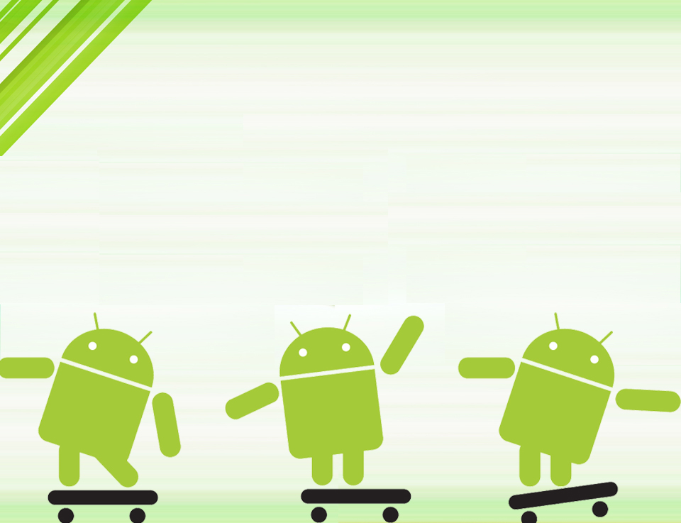
Questions?

Slide 20
Thank you

